Slide 1
Switching
Careers
Tilman Fabricius
Notes:
Welcome Guys to my presentation about my career switch!

Slide 2
“
“Let’s be honest:
Data Analytics sucks.”
-Anonymous Quote-
Notes:
Here is says its anonymous but erin told me i could use her name as well which i should have done to make it more personal
but ja lets be honest:
All the numbers, all the code
there is math
there is statistics
Who likes that?
You know what everybody likes?

Slide 3
Food
Everybody loves:
Notes:
Pretty sure if i do a Hypothesis test on if people love food more than data analytics
I would get a statistically relevant result
and a really small p value

Slide 4
WHAT TO DO?
I live in the City Center
I live above a Restaurant
Space might be available
I WILL OPEN A RESTAURANT
Notes:
I am a better cook than data Analyst
so what can go wrong?

Slide 5
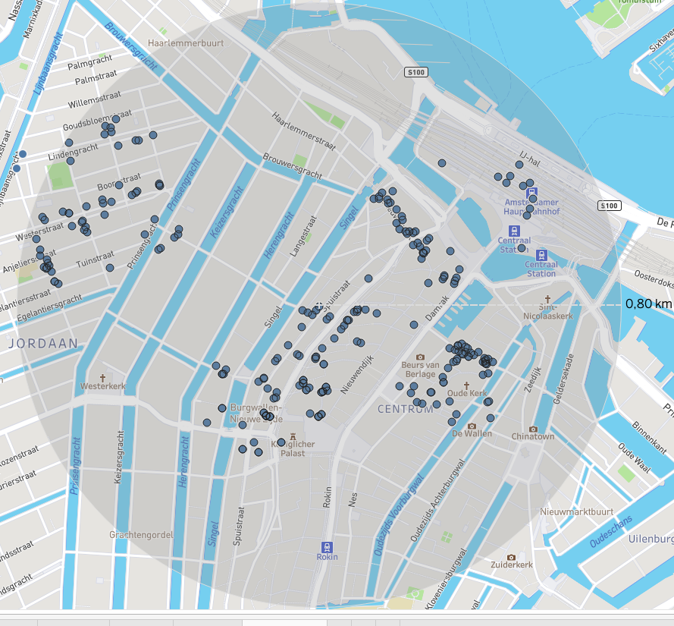
APPROACH
Looking at all restaurants around my location
Looking for the option with the highest chance of success
Notes:
I used the google maps Api
to give me all restaurants around my location
Info included:
Name Type Price Level Rating Amount of Ratings
Lets take a first look:
- Here is where I live
-central station
-City center
- dam
- de wallen
- china town
-Grachten living area
If you wonder why there are no restaurants there
api only give 60 per search so i had to search with
differnt locations around my location

Slide 6
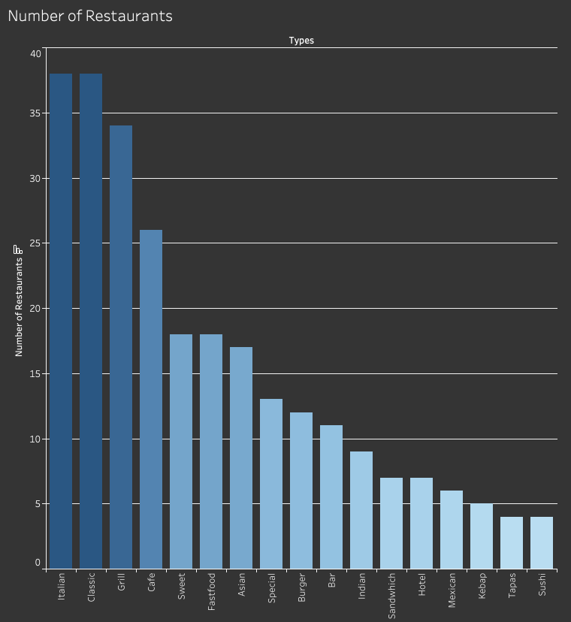
Notes:
Some descriptive statistics
I was interessted which cuisine had the most amount of restaurants in that area

Slide 7
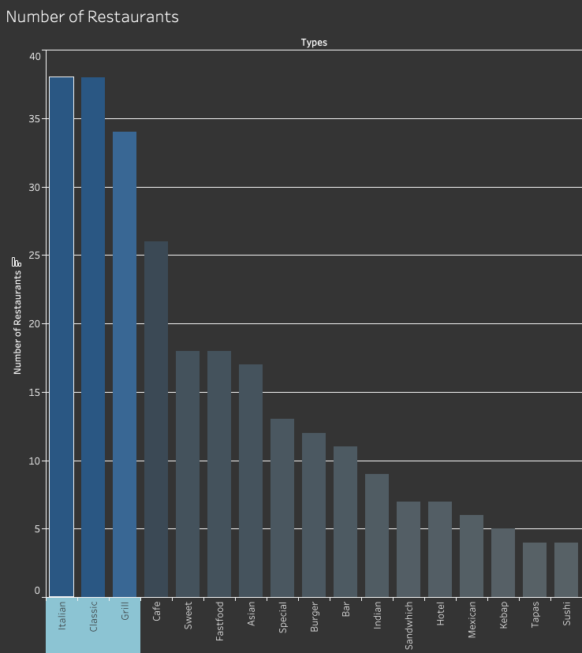
Notes:
As you see
Italian Calssic And Grill
Classic is fine dining and normal restaurant not specialised
Grill includes all steakhouses

Slide 8
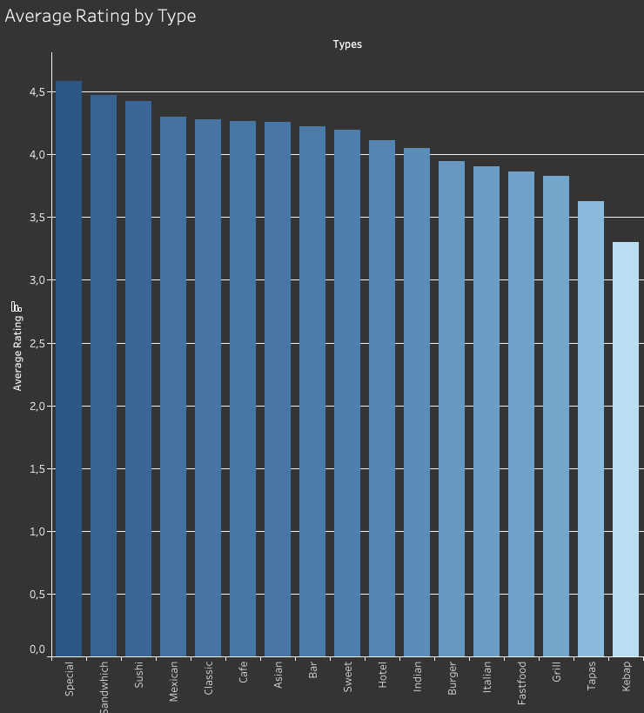
Notes:
All quite close togehter
Highest are Special restauratns and Sandwich places
Special restaurants are all restauratns that didnt fit in a other category
for example theater restaurants where they have perfomrances
or a vegan restauratn
or a empanada restaurant
you get the picture
Dutch peopl love there sandwiches
Kebap last place

Slide 9
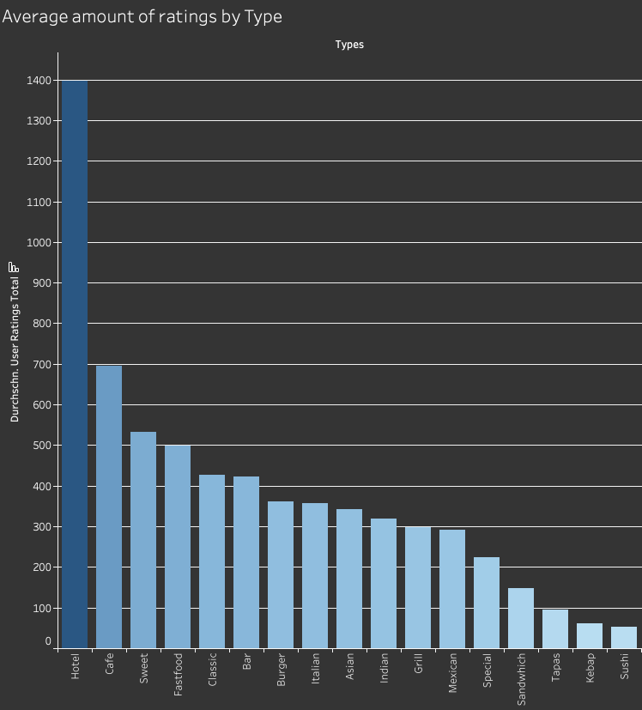
Notes:
Average amount of rating
to get an idea of how popular which cuisin is
Hotel highest, makes sense but cant really compete with hotels, since my apartment is to small
People like Cafes
Sweet places like Pnacakes shops and fastfood ofcours

Slide 10
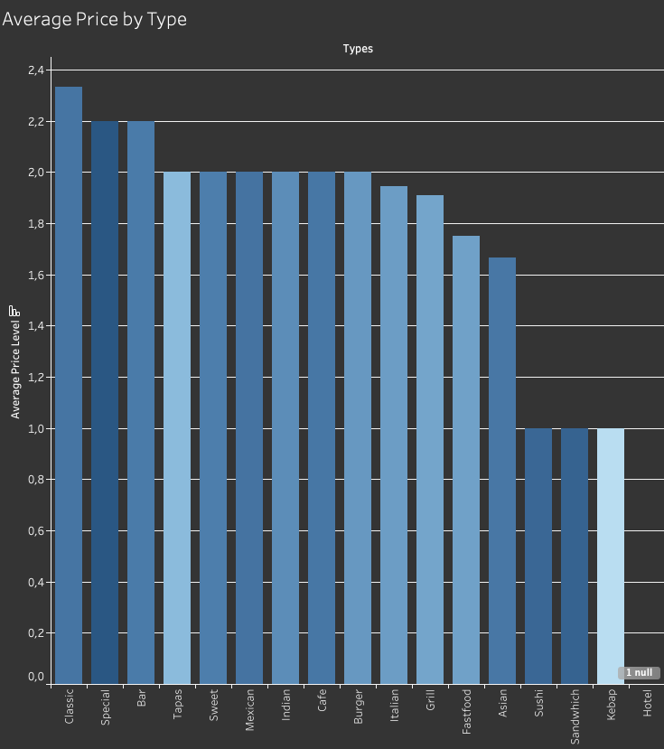
Notes:
Also looked at the prices
Google divides it into 5 categories
Unfortunately only 35% of the places had a value given to them
so cant use it to much
and also does not vary that much as you can see
it starts at 0 and goes to 4 but not one had a 0 in the data set so really goes form 1-4

Slide 11
PROBLEMS
No correlation between price, amount of ratings and the rating
Multiple conclusion from the data
Notes:
I ran into a few problems
There is no correlation between any of the numeric values
I ran the correltaion test and the result where between -0.1 an 0.1 so no correlation to speak of
second there are multiple conclusion to take from each graph
for example many italian restaurants so the must be running well 1 more is good or too many italian restaurants cant open another one
other example
kebap was lowest rated so a chance for a really good kebap restaurant or people just dont really like kebap in amsterdam
So i had to dig deeper

Slide 12
LOCATION
Location, Location, Location
- Harold Samuel -
Notes:
I started to look at the location

Slide 13
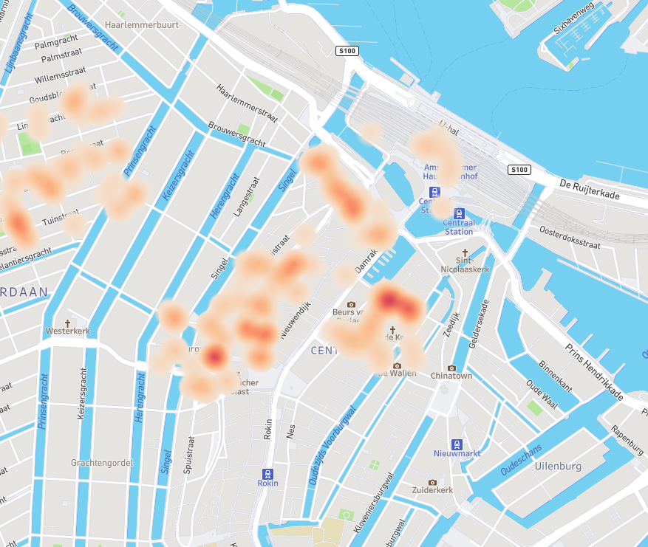
Notes:
Now remember my location is fixed i can not adjust my location according to the data
if you look at this heat map you see again a lot in the center
and alot arond the dam area and also around my location

Slide 14
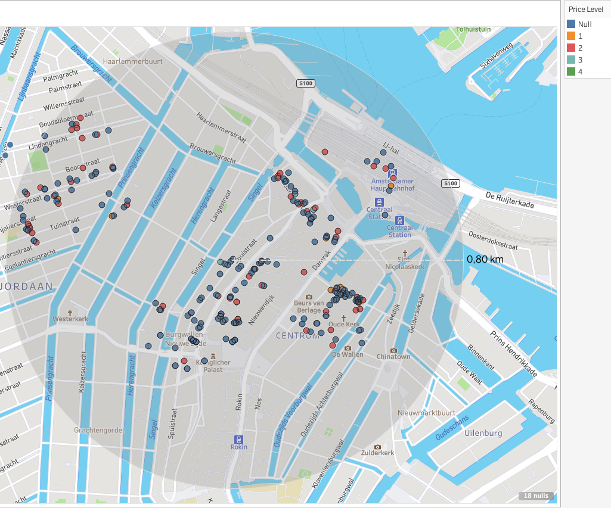
Notes:
I tried to look at the price level and the location
but as you see must are null values and the most others are 2 values
There are no trends to be seen from this

Slide 15
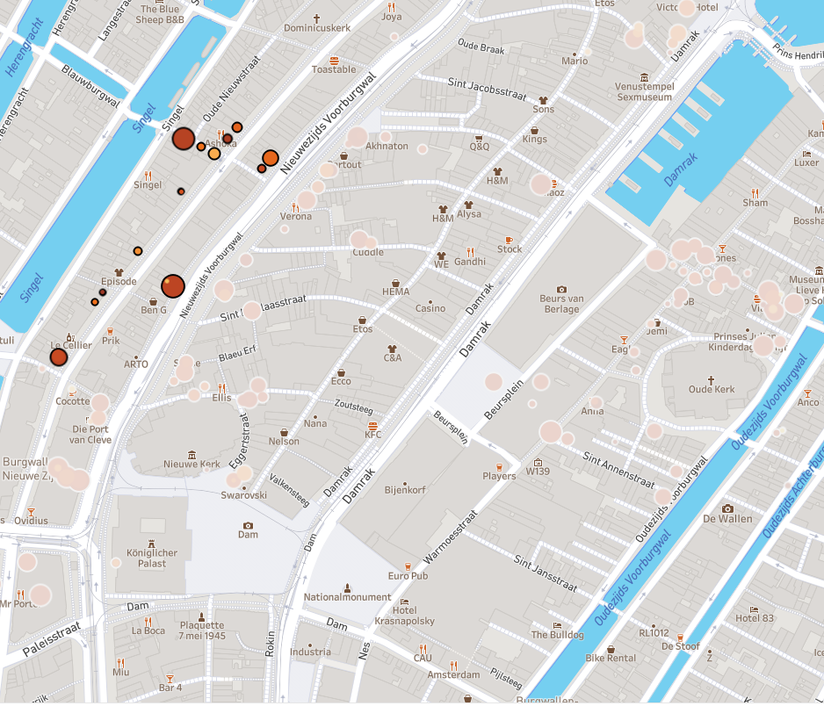
Notes:
Now if we zoom in
you can see that in my street the bubbles are mostly small and the size depends on the amount of ratings
exept for his one but thats a bar
and that does make sense since the street is just outside the typical tourist area you either wlak in the center or you walk by the water wy would you walk in the middle
So from that i started to make my conclusions

Slide 16
CONCLUSION
Maybe Fusion
Notes:
I need a concept that works well but does not need a huge amount of people

Slide 17
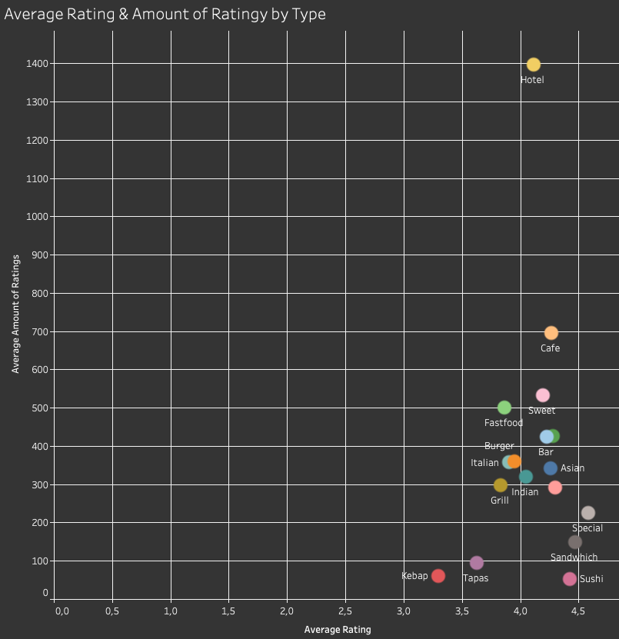
Notes:
So i started to look at the type of restaurant by amount of ratings and how high the rating is
So I need to be in the bottom left corner
High rated but not mainstream so to say
So that leaves me with Special, Sushi and Sanwich including a typo
And here is where Data connects with comment sense
no one wants to buy sushi from a white guy
so i looked at the other 2

Slide 18
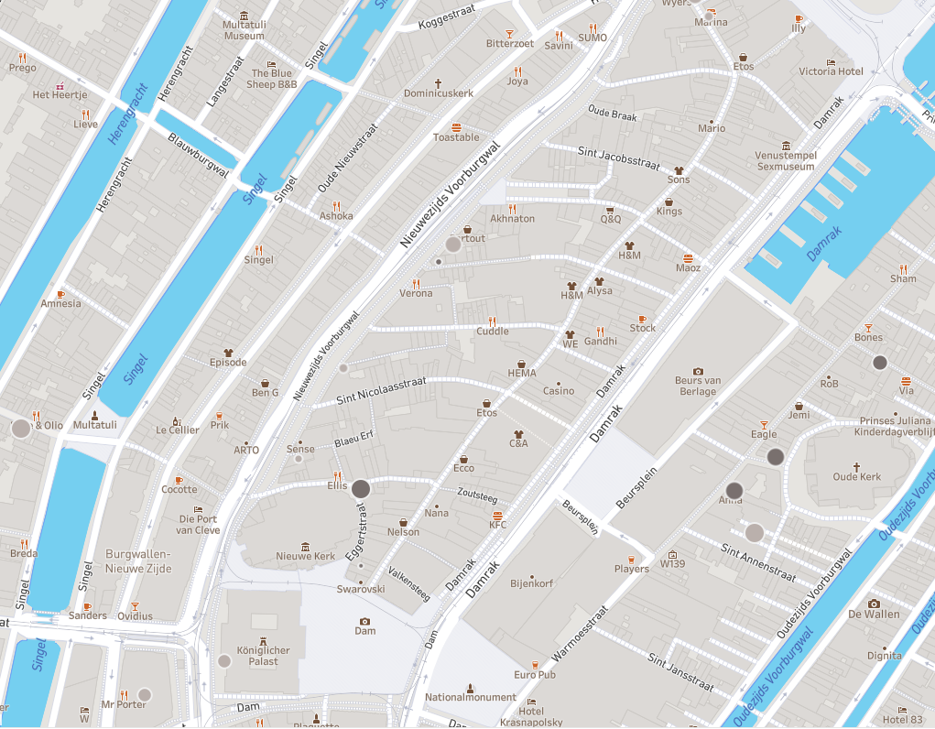
Notes:
And as you see there are no special or sanwich shops in the whole street, also the ones that are msot close by are not that high rated,
since the size of the bubble shows the rating of the shop
So I came to the conclusion to open a Special Sanwich Shop

Slide 19
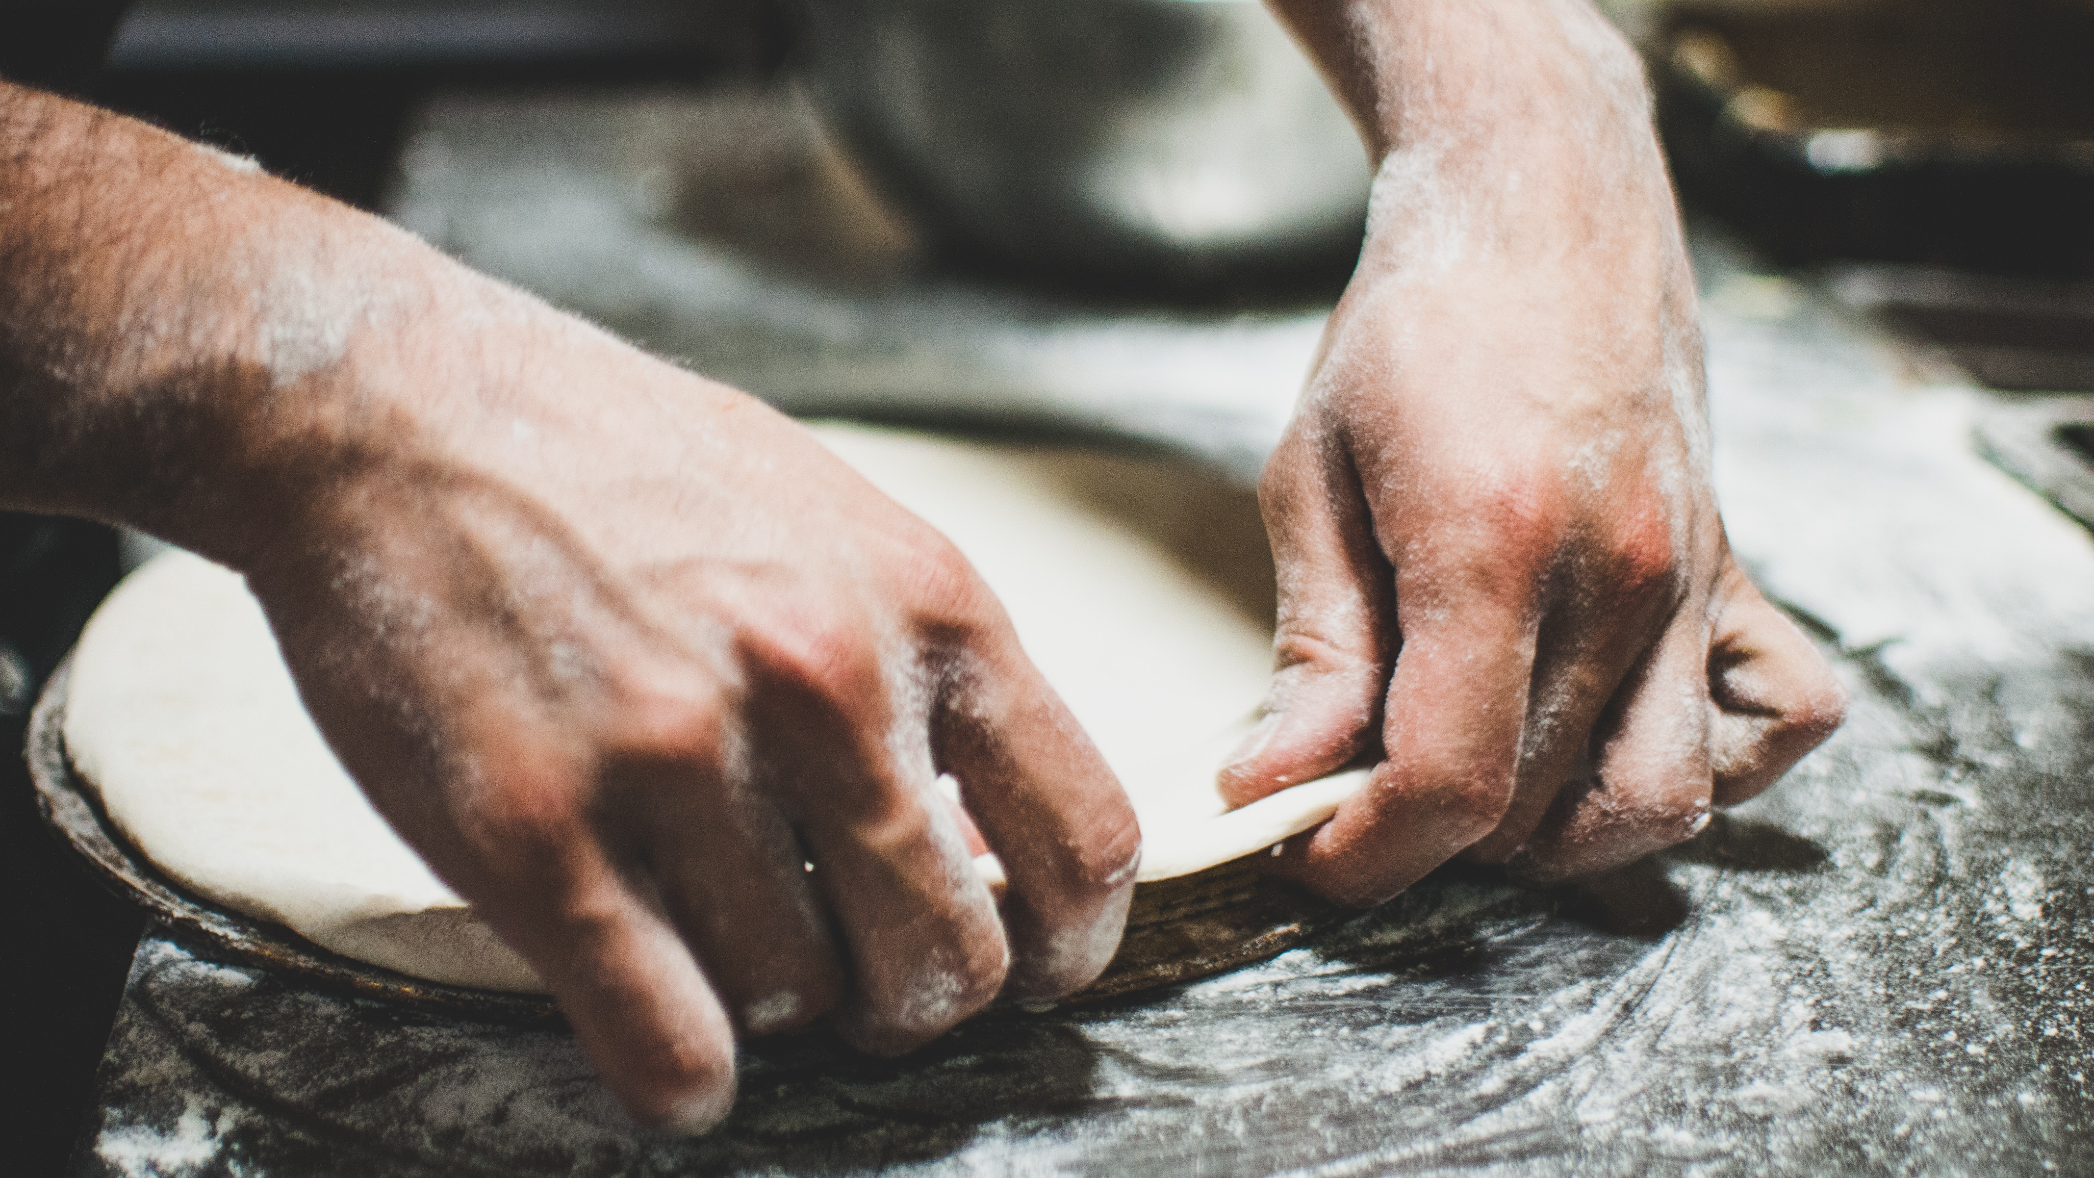

German Sandwich Shop
Bretzel, Brot & Butter
Notes:
A german Sanwich Shop
That i will call
Bretzel Brot und Butter
since we all now that dutch bread can not really compete
with german bread when it comes to quality and variety
I think it will fit right in.
And you can put everything on your bread from Sauerkraut to Schnitzel
every stereotype will be covered.
So shoutout to Jan who said from the begining of my project that a german restaurtant would be the best and indeed it is
Whcih choose 2 things Jan is a really good teacher and data analytics does indeed suck since he had the answer in the begining without all the work.
And here is the logo in cas you wondered

Slide 20
Thanks!
https://edition.cnn.com/travel/article/germany-best-bread/index.html
Notes:
So thank you very much and for all people who dont believe me, here is a link that explains why german bread is the best in the world
Thanks!

Slide 21
Content in two columns
Content A
Content B
Content itself is what the end-user derives value from also can refer to the information provided through the medium, the way in which
Content itself is what the end-user derives value from also can refer to the information provided through the medium, the way in which

Slide 22
Content in three columns
Content A
Content B
Content C
Content itself is what the end-user derives value from also can refer to the information provided through the medium,
Content itself is what the end-user derives value from also can refer to the information provided through the medium,
Content itself is what the end-user derives value from also can refer to the information provided through the medium,

Slide 23
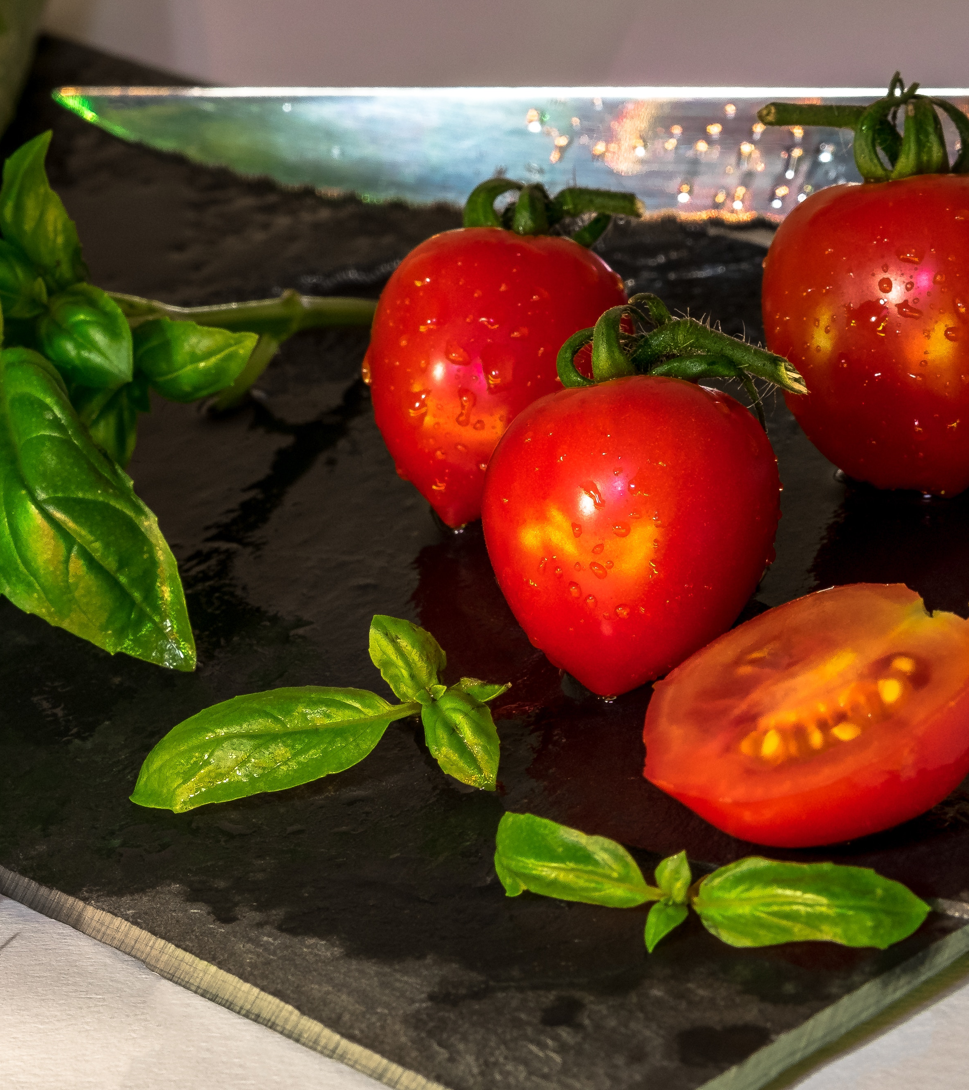
A Picture Is Worth A Thousand Words
Itself is what the end-user derives value from also.

Slide 24
Use Big Images To Show Your Ideas

Slide 25
Shapes to explain ideas
Title 01
Title 02
Title 03
Title 04
Your great description here
Your great description here
Your great description here
Your great description here

Slide 26
Features with icons
Service 01
Service 02
Service 03

Slide 27
Tables to compare data
 | A | B | C
Content A | 100 | 200 | 400
Content B | $67,000 | $56,000 | $78,000
Content C | 4500 | 60000 | $8,000

Slide 28
World Map
Europe
19,450000
USA
19,450000
Brasil
19,450000

Slide 29
56,790,500
Write here your big numbers

Slide 30
Funny Facts
56,790,500
130%
56,790,500
Revenue from sales
Project Achievements
Users around the world

Slide 31
The Process
01
Title 01
Write here your description
02
Title 02
Write here your description
03
Title 03
Write here your description
04
Title 04
Write here your description

Slide 32
Features with icons
Content A
Content B
Content C
Itself is what the end-user derives value from also can refer to the information
Itself is what the end-user derives value from also can refer to the information
Itself is what the end-user derives value from also can refer to the information
Content D
Content E
Content F
Itself is what the end-user derives value from also can refer to the information
Itself is what the end-user derives value from also can refer to the information
Itself is what the end-user derives value from also can refer to the information

Slide 33
Use charts to present data
Your Title
Your Title
Your Title
Your Title

Slide 34

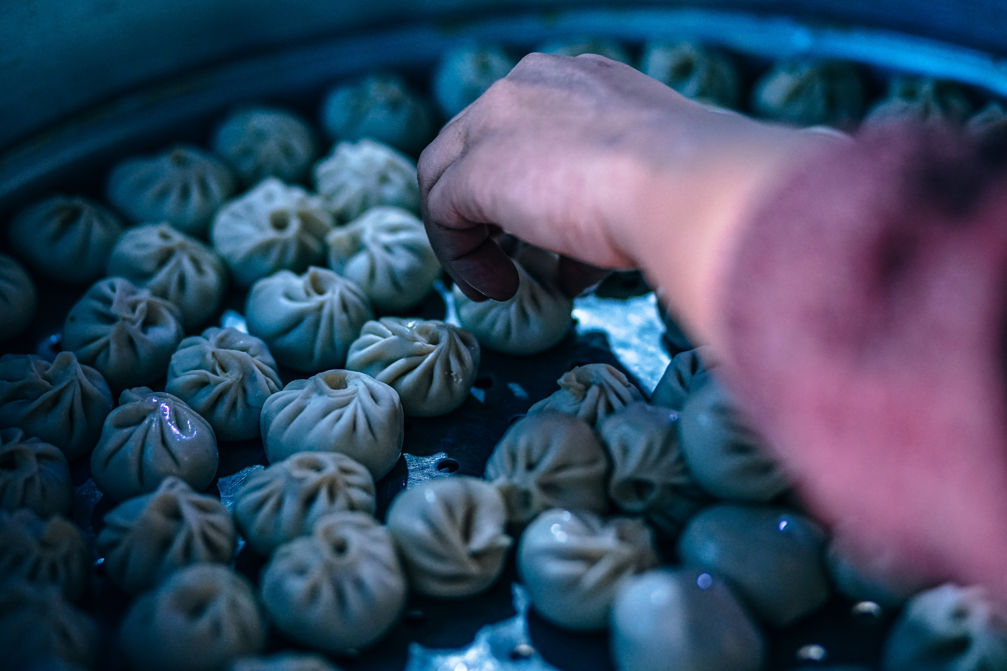
Mobile App
Itself is what the end-user derives value from also can refer

Slide 35
Laptop Project
Itself is what the end-user derives value from also can refer.

Slide 36
Desktop Project
Itself is what the end-user derives value from also can refer.

Slide 37
Thanks!
Any questions?
You can find me at: @username
myemail@domain.com

Slide 38
Credits
Special thanks to all people who made and shared these awesome resources for free:
Presentation template designed by powerpointify.com
Photographs by unsplash.com

Slide 39
Presentation design
This presentation uses the following typographies and colors:
Free Fonts used:
https://www.fontsquirrel.com/fonts/roboto-condensed
Colors used:

